Slide 1
Translation Regulation with Artificial Introns
Brandon Dorr, Kylie Standage-Beier, Xiao Wang Ph.D.
School of Biological and Health Systems Engineering
4/14/2018

Slide 2



What is Synthetic Biology?
Design and control organisms
  Biosensors
  Compound and material production
  Therapies
Cellular Factories

Slide 3
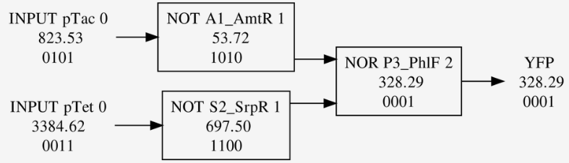
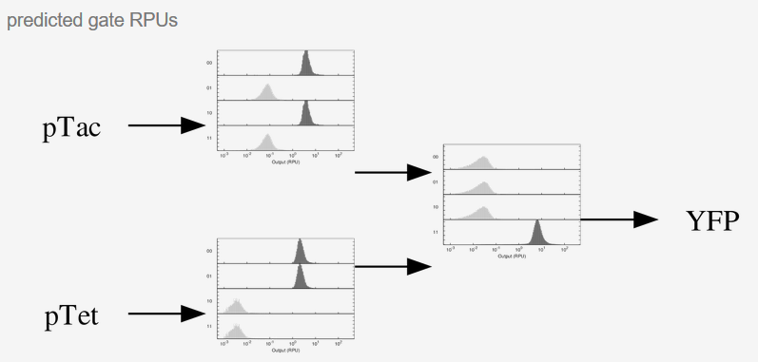
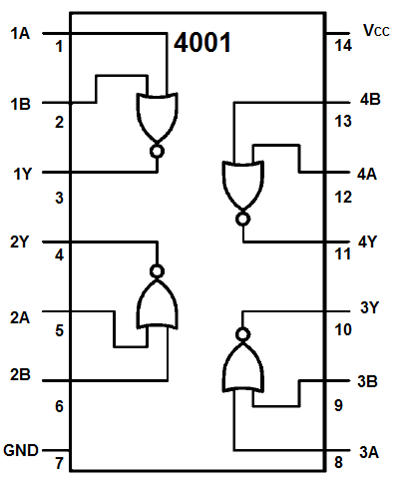
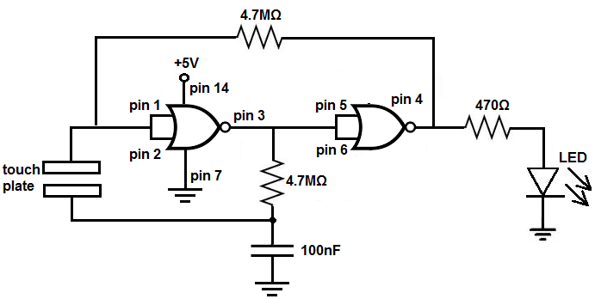
Synthetic Biology & Electrical Engineering
Integrated circuits are essential for the development of modern computing
Combination of genetic components to form complex gene circuits provide new solutions
Program biological systems to make decisions based on their environment and stimulus
(Cello)
(How to Build a Touch On-Off Circuit with a 4001 NOR Gate Chip)

Slide 4


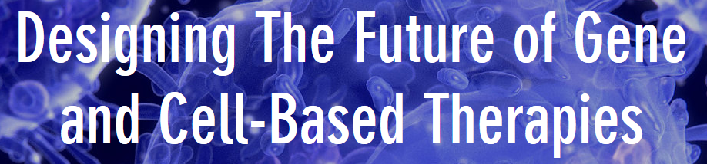
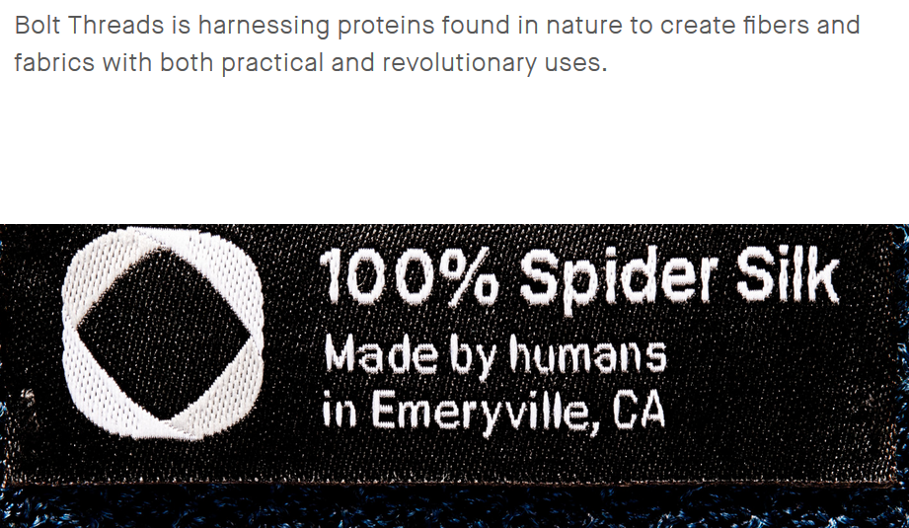
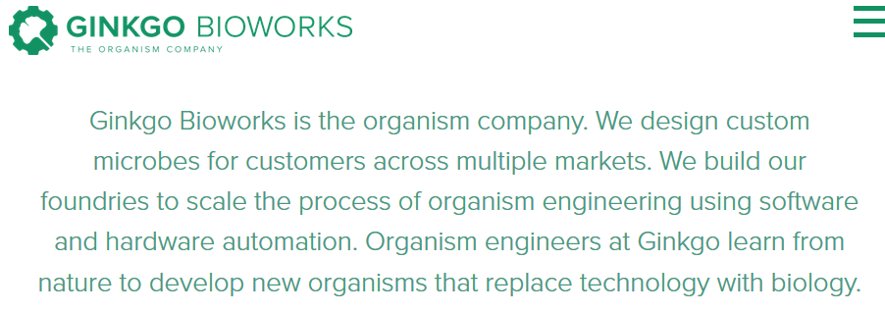
Synthetic Biology Advantages
Ability to utilize chemistry and create compounds
Directly interact with chemical stimuli
Ability to multiply and allow for scaling
(Amyris)
(Bolt Threads)
(“The Organism Company”)
(“Senti Biosciences”)
Notes:
Chemical stimulus + Chemical/Complex protein producton: Synthetic biology is a valuable tool for the development of new compounds. With the new development of mega-startup companies within the field, many of the success stories have been related to compound production. Two key demonstrations of success involve the production of an antimalarial drug precursor (artemisinin), and spider silk, which are both from engineered yeast (Ro et al., 2006) (Service, 2017). Yeast have been a powerful bio-producer for much longer than rational genetic engineering has existed, however now they can serve as producers of many more compounds utilizing a very similar fermentation process.

Slide 5

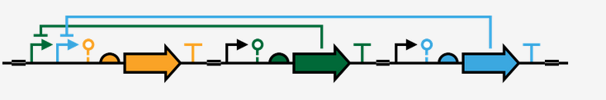
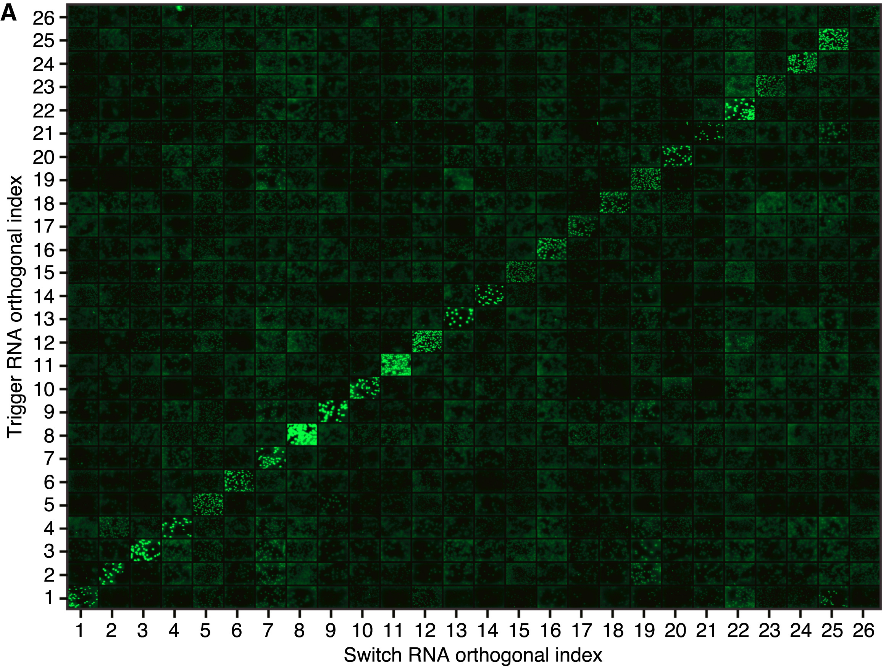
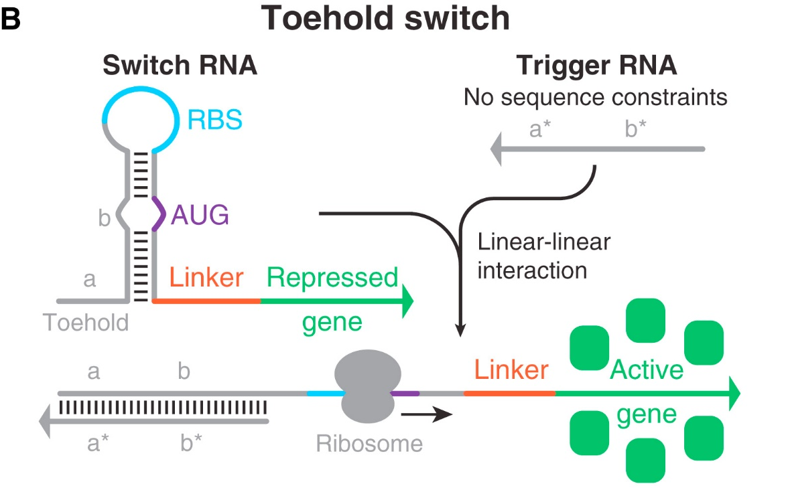
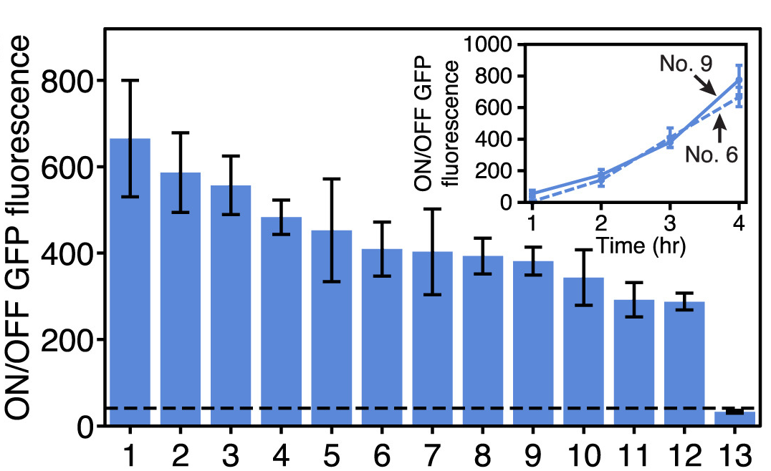
Project Inspiration: Gene Regulation Parts
Gene regulation parts are essential for creating genetic circuits
  Modular
  High Specificity
  High Dynamic Range
Toehold switch
(Green et al., 2014)
(Cello)
Notes:
Parts which can regulate gene circuit activity are essential for producing a working gene circuit. Ideal regulators are versatile and have low off-target activity. Simple adjustments can allow for specific regulation of a desired target. As the molecular interactions within the cell are not insulated from each other, or simply connected with wires, chemical specificity often governs specific interactions between biological components (Lu et al., 2009). Implementation of specific molecular interactions allows for more complex genetic circuits, which allow for biological computing. Additionally, regulators need to be effective. When different expression states can be easily identified, a signal can be realistically passed through the circuit. A regulator which has high dynamic range, in this sense, should yield a substantial change in the target protein production. High dynamic range can be achieved with a light switch. The light switch (the regulator) controls the lightbulb (protein production) and allows for very discernable on and off states. However, in biological systems, the on and off states are often not as discernable as in electrical systems, therefore effective regulators are desired. Finally, an easy to implement regulator, or new genetic component, is modular, which can be quickly and easily introduced into a created circuit. The low availability of orthogonal and high dynamic range regulatory systems is limiting when attempting to create more complex multi-stage genetic circuits. This project looks to create a novel gene regulation system in a eukaryote host, S. cerevisiae, utilizing artificial introns and complementary trans-acting RNAs.

Slide 6

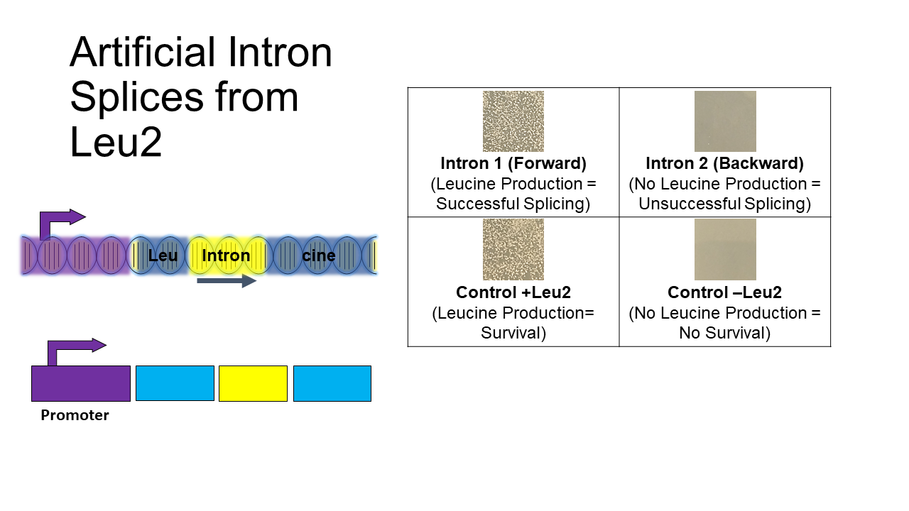
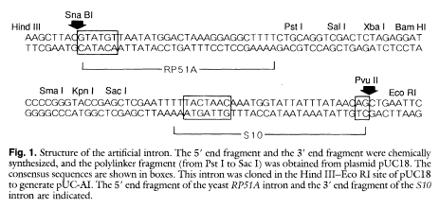
Artificial Intron Demonstrates Directional Specific Splicing
MMM
***
(Yoshimatsu and Nagawa, 1989)

Slide 7
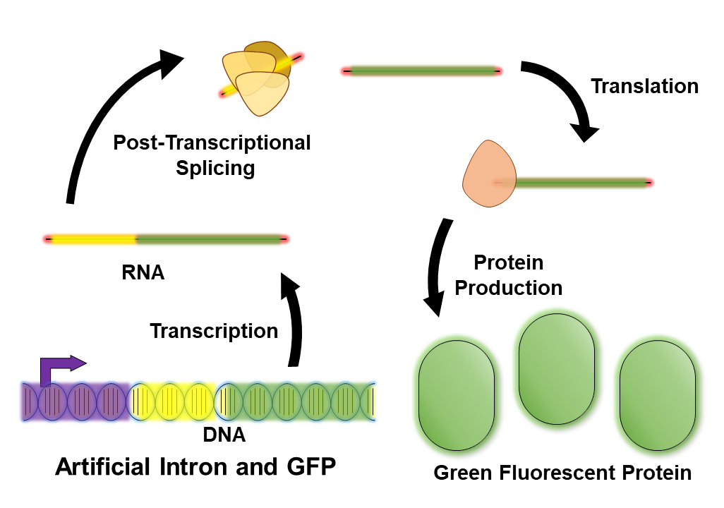
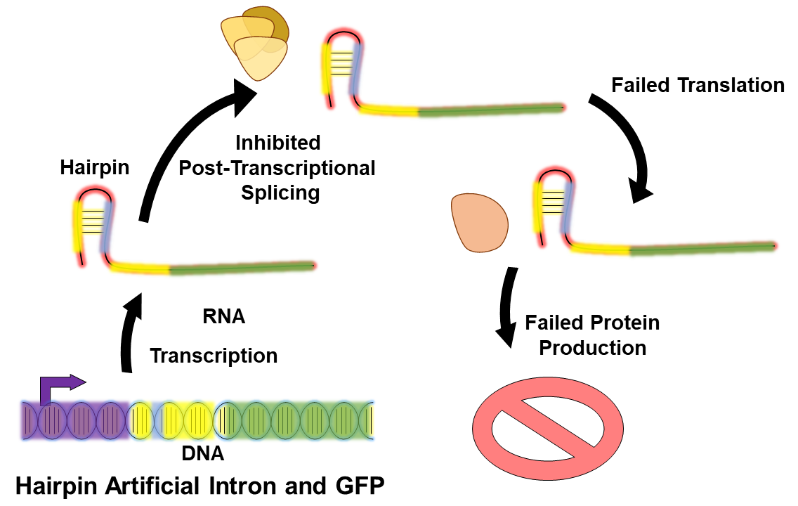
Hairpins Designed to Inhibit Splice Site Recognition

Slide 8
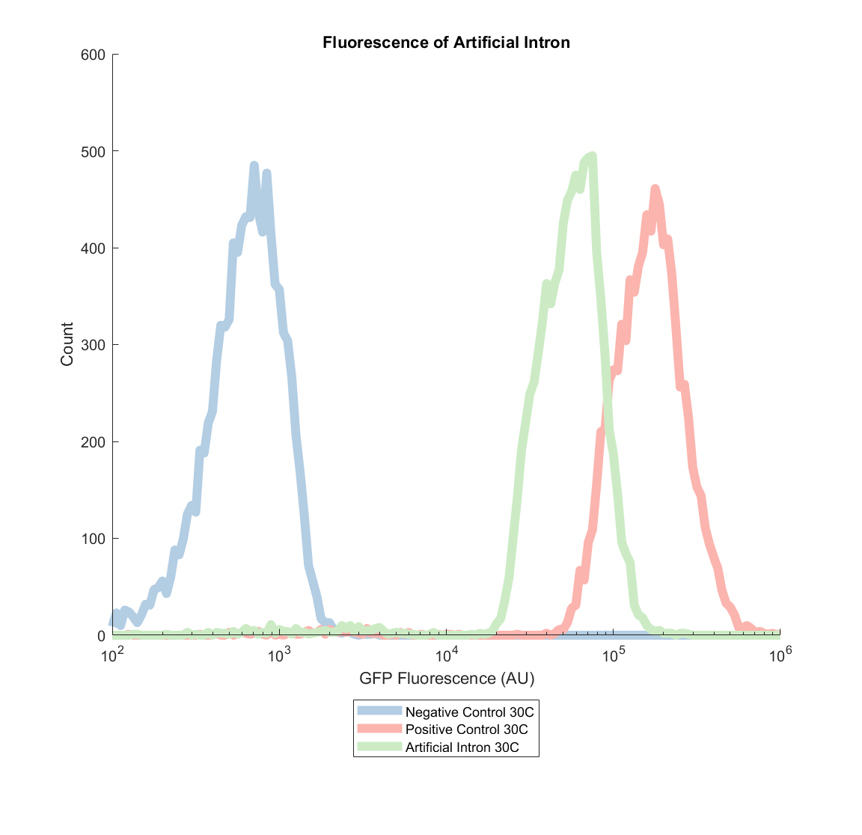
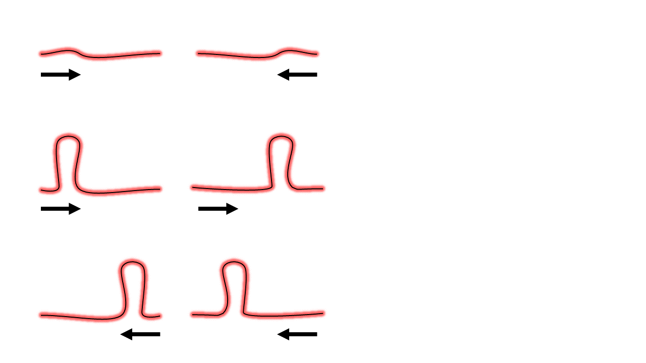
Intron Splicing Inhibition with Hairpins
Gal
yeGFP
Gal
AI
yeGFP

Slide 9
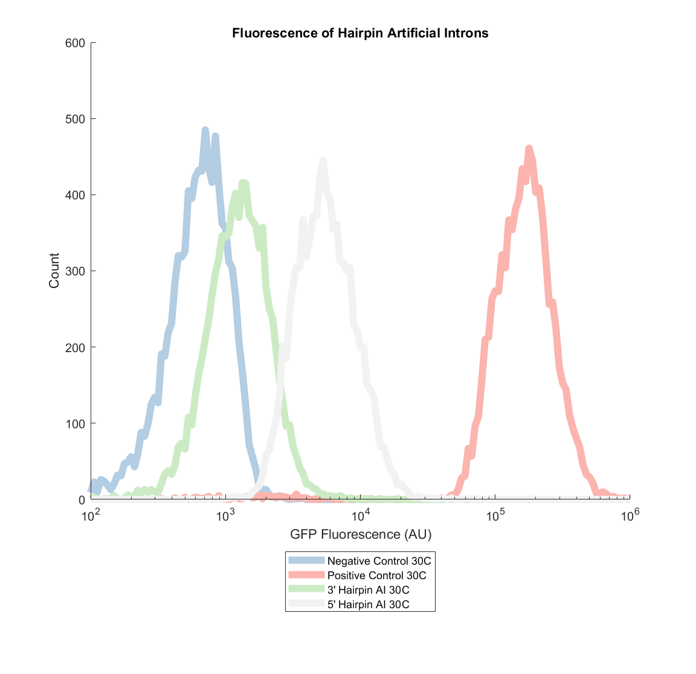
Intron Splicing Inhibition with Hairpins
Gal
yeGFP
Gal
3’ Hairpin AI
yeGFP
Gal
5’ Hairpin AI
yeGFP

Slide 10
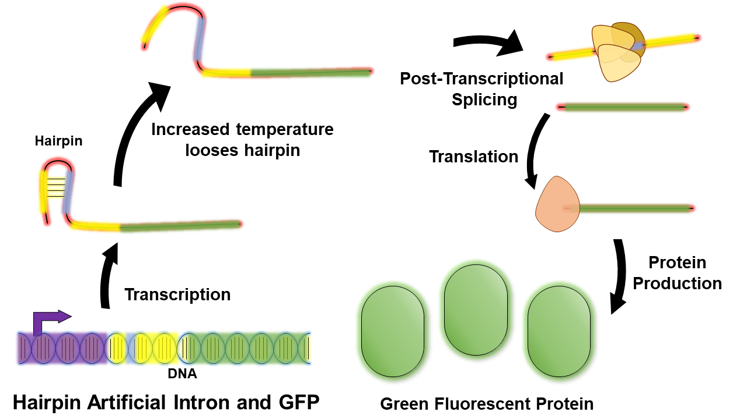
Temperature Sensitivity of Intron Splicing Inhibition

Slide 11
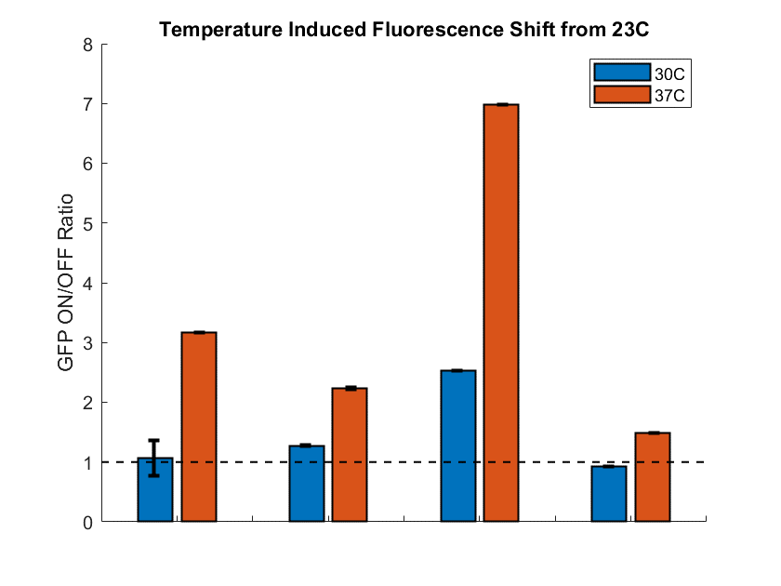
Temperature Sensitivity of Intron Splicing Inhibition
Gal
AI
yeGFP
Gal
5’ Hairpin AI
yeGFP
Gal
3’ Hairpin AI
yeGFP
Gal
yeGFP
AI
5’ Hairpin
3’ Hairpin
yeGFP
*AI = Artificial Intron

Slide 12
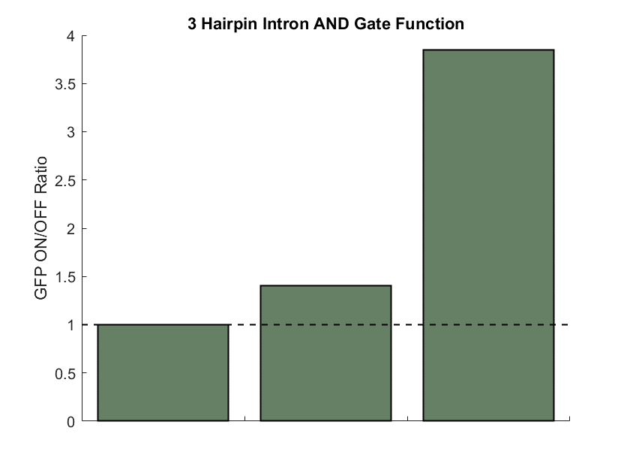
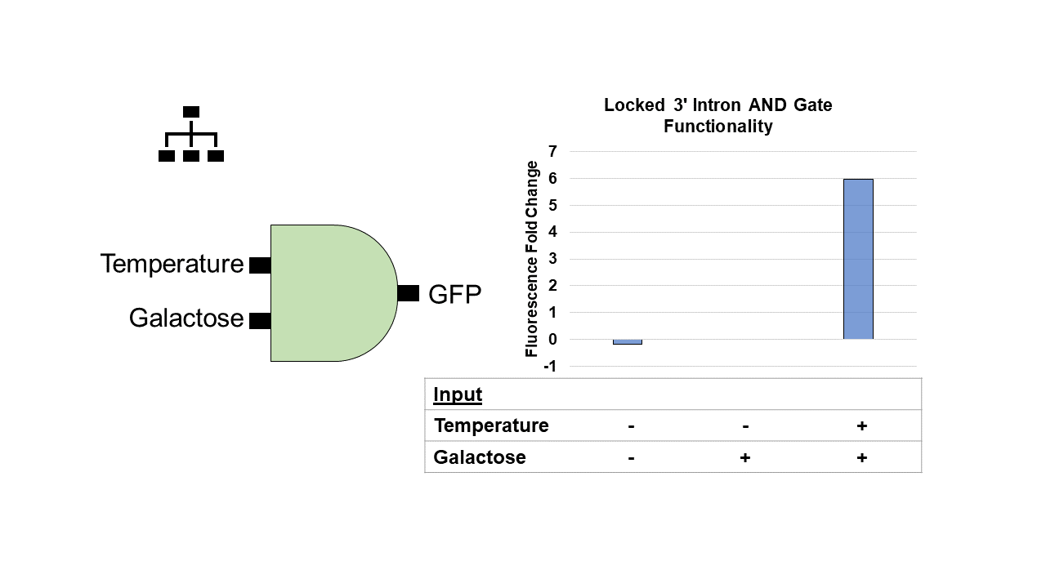
Logic AND Gate Functionality
Input
Temperature | - | - | +
Galactose | - | + | +

Slide 13

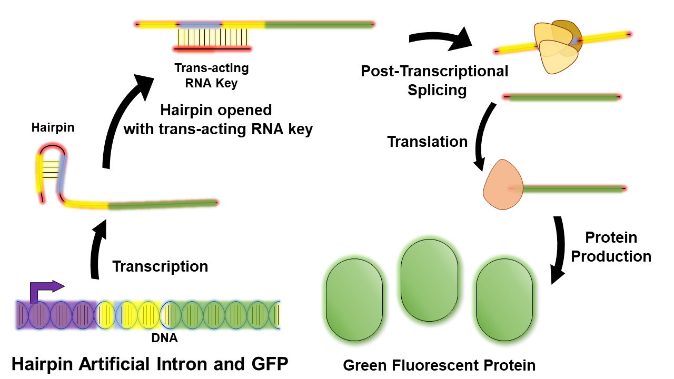
Future Steps: trans-acting RNAs to control intron splicing

Slide 14




Acknowledgements
Dr. Xiao Wang
Kylie Standage-Beier
Qi Zhang
David Menn
All Xiao Lab members
ASU/NASA Space Grant

